Slide 1

Customer Segmentation for an E-commerce
Presented By:-
Akash Nailwal

Slide 2
Content
Problem Statement
Data Used
Segmentation
RFM Analysis
K-means Clustering
Clustering Analysis

Slide 3
Problem Statement
An e-commerce company has a variety of customers. Every customer has a different set of tastes and interests and may belong to different financial levels. Therefore, it is a heavy challenge for the marketing and strategy team to decide what products it should be promoting or what kind of campaigns will lead to the most lucrative results. Spending score is one such metric through which you can segregate customers. Spending score is not just determined by the financial situation, but it is also based on other factors such as customer behavior, the kind of products a customer buys, etc. In this project, your marketing team basically wants you to identify the customers who will most easily converge and buy products. In doing so, you must show the different segments in percentage and also predict the kind of products and marketing campaigns that will be the most successful with your customers.

Slide 4

Dataset Used UCI Machine Learning Repository: Online Retail Data Set

Slide 5

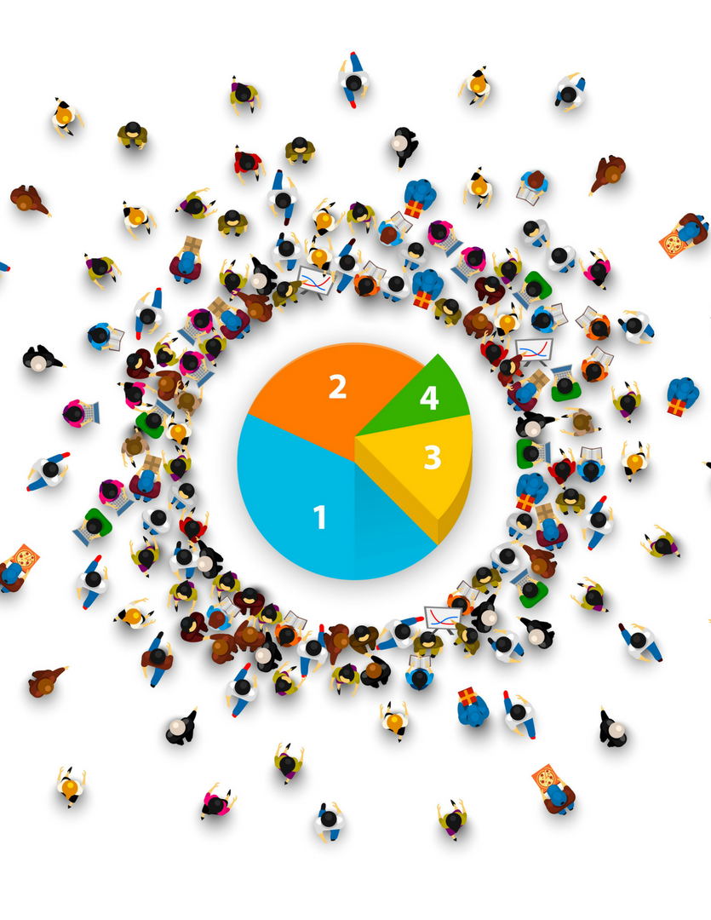
What is customer segmentation?
Customer segmentation is the process of tagging and grouping customers based on shared characteristics. This process also makes it easy to tailor and personalize your marketing, service, and sales efforts to the needs of specific groups
Segmenting customers based on who they are
Age, Geography, Urbanization, Income, Relationship status, Family, Job type
Segmenting customers based on what they do
Basket size, Share of wallet, Tenure, Loyalty

Slide 6
Recency Frequency Monetary
Recency. How recent was the customer's last purchase
Frequency. How often did this customer make a purchase in each period
Monetary. How much money did the customer spend in each period

Slide 7
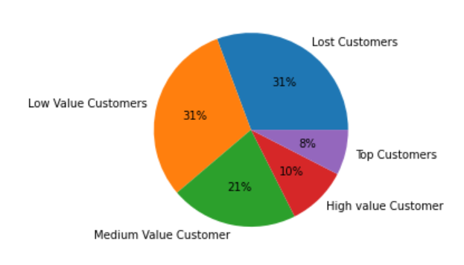
Rating Customer based upon the RFM score
RFM score >4.5 : Top Customer
4.5 > RFM score > 4 : High Value Customer
4>RFM score >3 : Medium value customer
3> RFM score >1.6 : Low-value customer
RFM score<1.6 :Lost Customer

Slide 8
RFM Analysis
Lost Customers(31%) & Low value Customer(31%) :
We need to send some special discount offers to this category to retain them back
Medium Value Customer(21%):
These are the group who visit the store with certain gap but has good monetary value
we can improve our service to them and ask them for feedbacks
High Value customers(18%):
These are the group which visit the store very frequently and has high monetary value also. We need to keep them retained and provide them with some loyalty points.

Slide 9
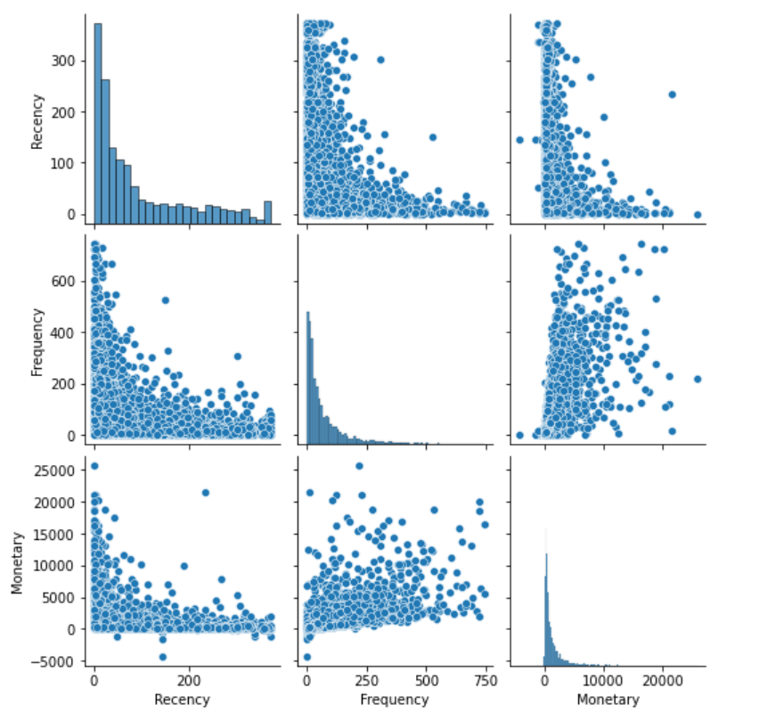
Pair plot to show the relation among (R-F-M)
From Recency and Monetary plot we can observe that people who bought recently are contributing most to the total monetary value
From Frequency and Monetary plot it gives a positive correlation, the more frequent is the customer the better is the amount spend by him

Slide 10
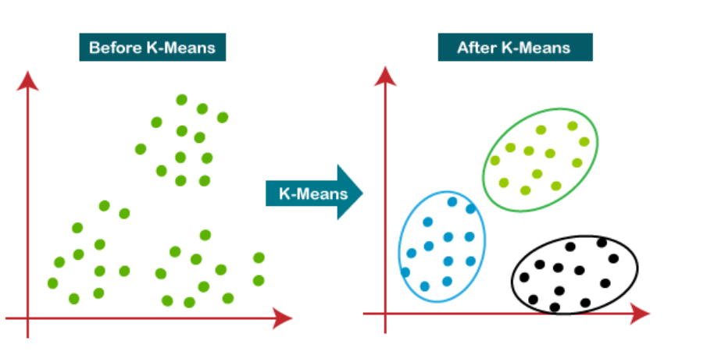
Algorithm used is K-mean Clustering
K-mean clustering determines the best value for K center points or centroids by an iterative process.
Assigns each data point to its closest k-center. Those data points which are near to the particular k-center, create a cluster.

Slide 11
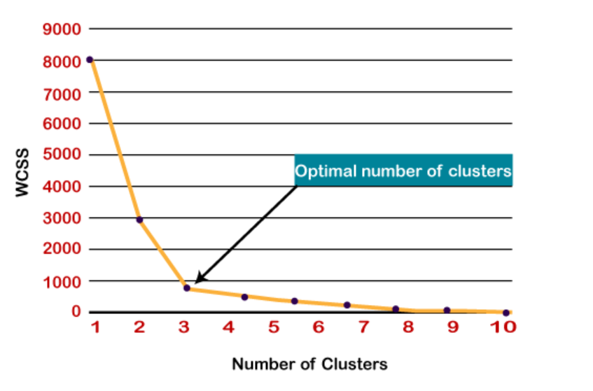
Elbow Method & Silhouette score
The Elbow method is one of the most popular ways to find the optimal number of clusters. This method uses the concept of WCSS value. WCSS stands for Within Cluster Sum of Squares, which defines the total variations within a cluster.
Silhouette score is 0.518 for K=4
which shows a good separation between the clusters itself.

Slide 12
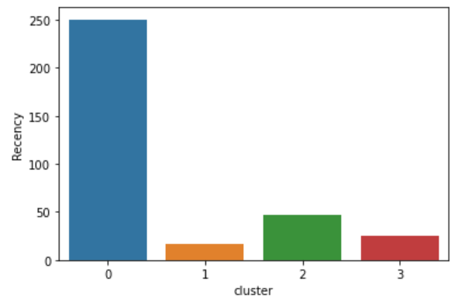
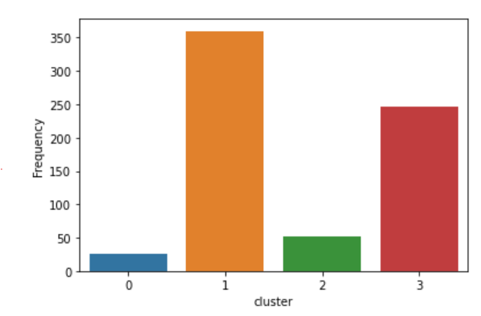
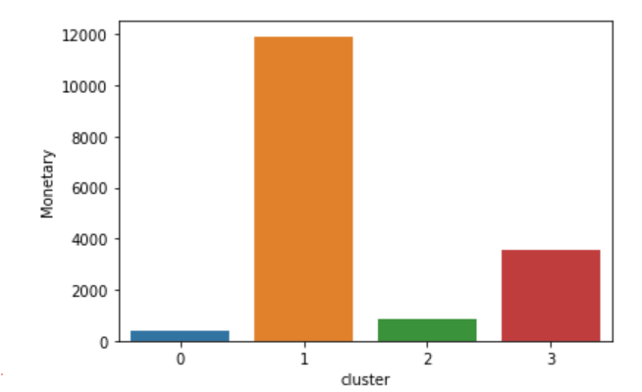
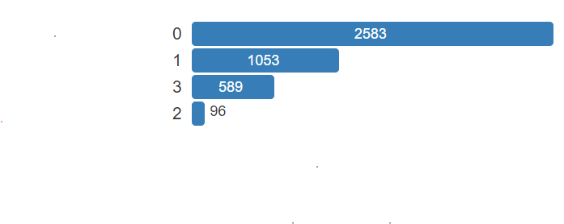
Cluster Analysis

Slide 13

Analysis
Cluster 0 : It is a group of customers who has not visited the store in a long time, or they are inactive now, we can send them promotional coupons so that they become active again.
Cluster 1 : These are the topmost customers with all the RFM factors at the best level possible. We can provide them with some loyalty points, so that can refer our services to others also.
Cluster 2 : Customers with low recency and low frequency are new customers. A targeted follow-up may convert them into repeat customers.
Cluster 3 : This group has a potential to become over next valued customer if we focus on them, they can increase our sale and as the count is also less in this group, we can target them individually also.

Slide 14

Thank You

